Slide 1
Credit EDA Case Study
This case study aims to identify patterns which indicate if a client has difficulty paying their instalments which may be used for taking actions such as denying the loan, reducing the amount of loan, lending (to risky applicants) at a higher interest rate, etc. This will ensure that the consumers capable of repaying the loan are not rejected. Identification of such applicants using EDA is the aim of this case study.
Created by-
Arunit Mukherji
Sandip Patra

Slide 2
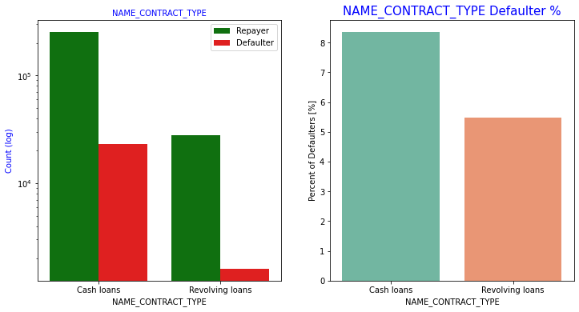
Categorical Univariate Analysis Contract type
Points to be concluded:
Cash loans are taken by a larger percentage of people than revolving loans
Revolving loans have many defaulters compared to its demand.

Slide 3
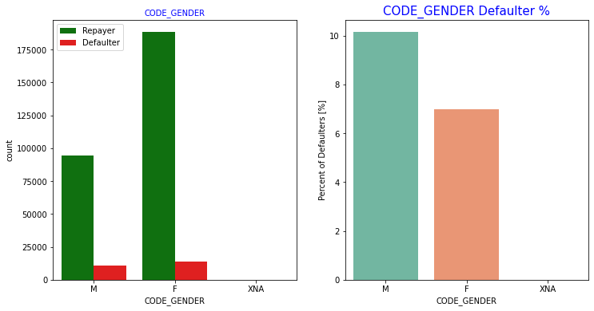
Gender Analysis
Males have a higher chance of not returning their loans, compared to women.
Females have taken a higher number of loans

Slide 4
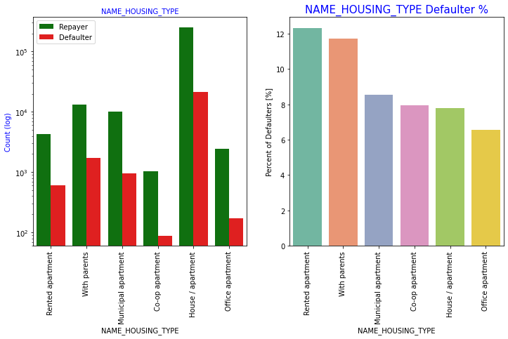
Analysis based on housing type
People living with parents and living in rented apartments have higher probability of defaulting
People living in office apartment have least default rate

Slide 5
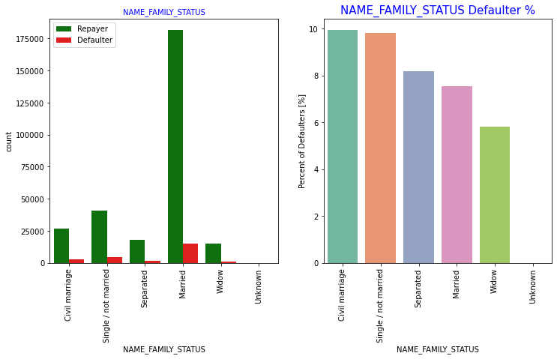
Analysis based on family status
Married people are most likely to take loans.
Widowed people are least likely
People having civil marriage have highest default rate and widows the least.

Slide 6
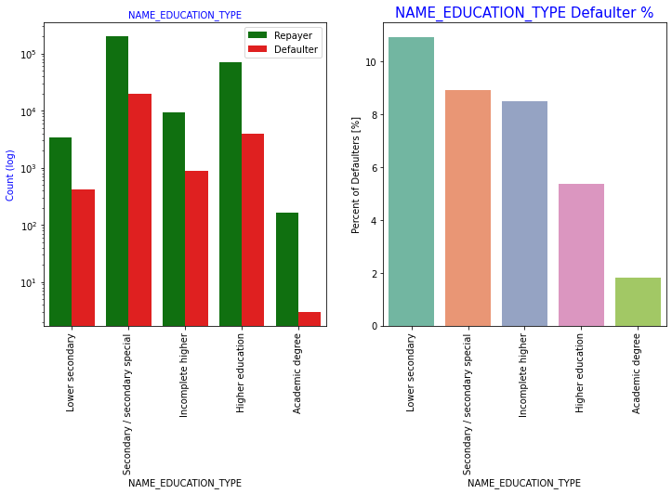
Analysis based on education
Majority of the clients have Secondary / secondary special education
Very few people taking loans have academic degree
People having academic degree default the least and are good targets
People having lower secondary degree default the most

Slide 7
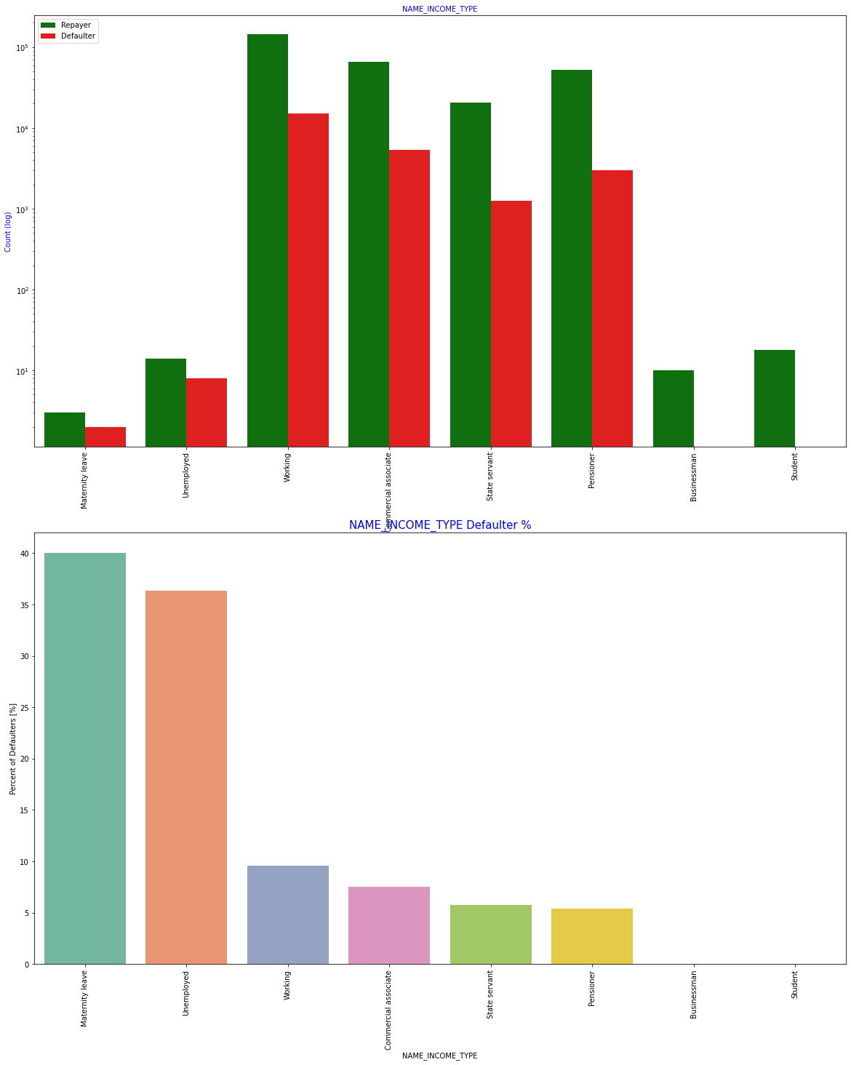
Based on Income type
People on maternity leave are the highest defaulters and a very bad target
Businessman and students have no default data and are good targets

Slide 8
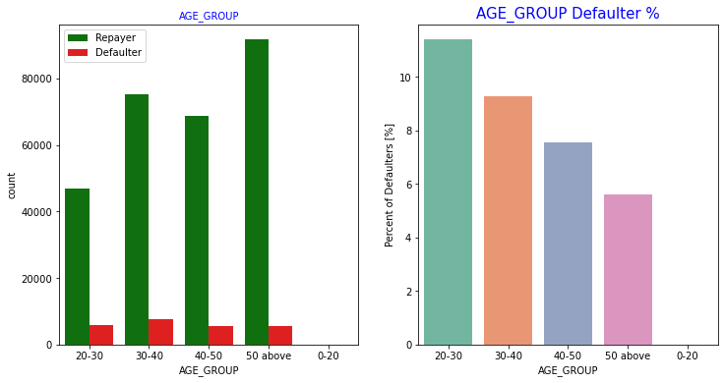
Analysis based on age group
The age group of 50 plus is a very good target because:
They have taken the maximum number of loans
They have a low default rate
The age group of 20-30 is not a good target due to high default rate

Slide 9
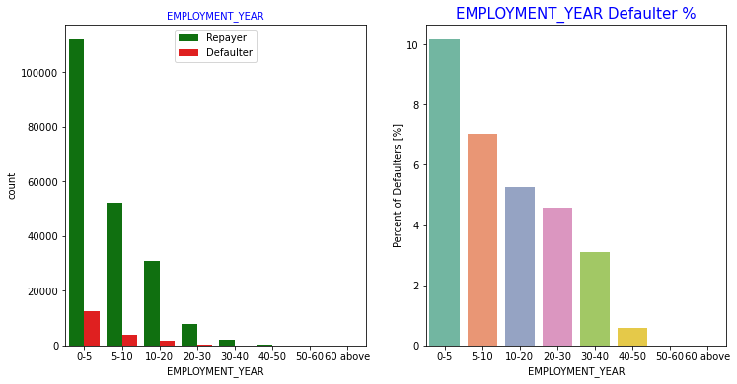
Analysis based on Employment Year
People who have been employed for more than 30 years are least likely to default
Freshers are not a good target as they have a high default rate

Slide 10
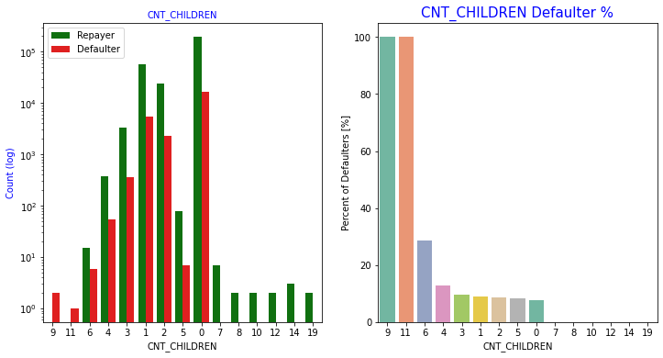
Analysis based on children count
The higher the number of children the more the loan defaulting probability
People with no children have taken maximum number of loans

Slide 11
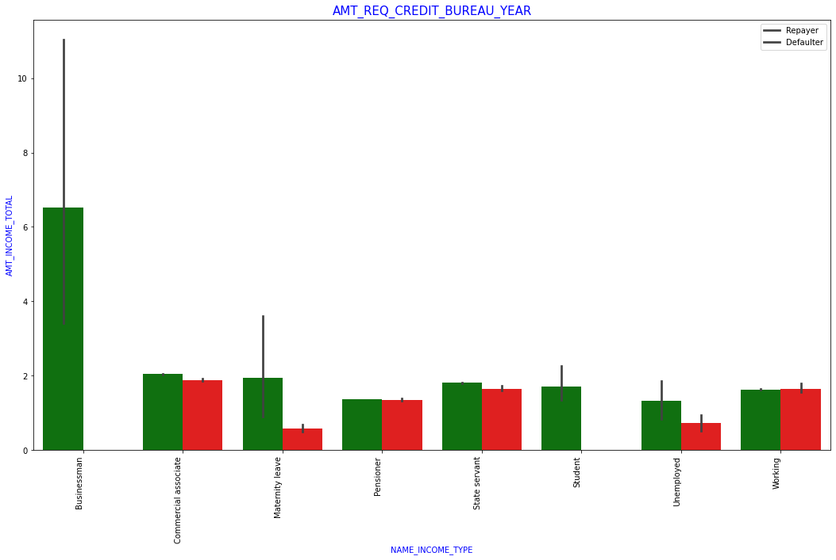
Categorical Bivariate Analysis
Businessmen seems to be a very good target since, they have the highest number of loans with 95 percent confidence
Businessmen have no documented default

Slide 12
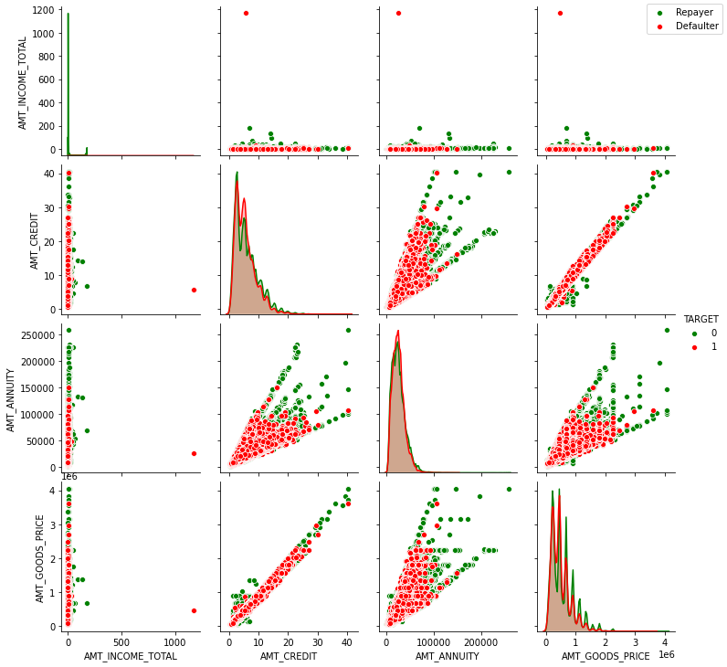
Numerical Bivariate Analysis
Amount credited has the strongest positive correlation with goods price and amount annuity
The higher the annuity and amount credit, the lesser the default

Slide 13
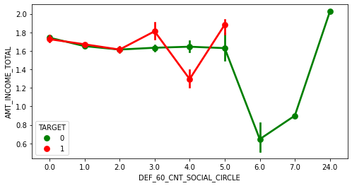
Bivariate analysis on Social Circle
People having social circle count greater than 5, their income falls and rises above 7 or more.

Slide 14
Who are less likely to Default Good Targets
People having Academic degree
Student and Businessmen
People above age of 50
Clients with 40+ year experience
Applicants with Income more than 700,000
People with zero to two children

Slide 15
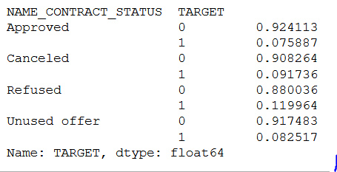
Inference
90% of the previously cancelled client have actually repaid the loan. Revisiting the interest rates would increase business opportunity for these clients
88% of the clients who have been previously refused a loan has payed back the loan in current case.
Refusal reason should be recorded for further analysis as these clients would turn into potential repaying customer

Slide 16
Thank you

